Slide 1
FLIGHT BOOKING SYSTEM

Slide 2
Project background:
Flight booking systems have become indispensable tools in the modern
travel landscape, revolutionizing the way individuals plan and book their journeys.
This abstract offers a succinct overview of flight booking systems, highlighting their
significance, functionalities, challenges, and future prospects.
Flight booking systems serve as digital platforms that enable users to search, compare,
and reserve flights from various airlines. These systems leverage advanced
technologies, including user-friendly interfaces, real-time data integration, and secure
payment gateways, to streamline the booking process.

Slide 3
Description of project:
The flight booking system described in the SQL code serves as a foundational structure
for managing airline operations and passenger bookings. It acts as a centralized hub
where crucial information about airlines, airports, flights, and passengers is stored and
organized. This system is vital for ensuring smooth airline operations and efficient
passenger management.
Airlines List:
The Airlines List table contains details about different airlines, such as their names.
This table helps in identifying the airlines operating within the system and allows for
easy reference when associating flights with specific airlines.

Slide 4
Airport List:
The Airport List table stores information about various airports, including their names
and locations. This table is essential for identifying departure and arrival airports for
flights and helps in providing accurate airport information to passengers
Flight List:
The Flight List table manages detailed flight schedules, including information like the
airline associated with the flight, the plane number, departure and arrival airports,
departure and arrival times, available seats, and ticket prices. This table serves as a
central repository for flight-related information, enabling airlines to efficiently
manage their flight schedules and bookings.
Booked Flight:
The Booked Flight table records passenger bookings for flights. It includes details such
as the flight ID, passenger name, address, and contact information. This table helps in
managing passenger bookings and facilitates communication with passengers
regarding their travel details

Slide 5
Users:
The Users table stores information about users who can access the system. This
includes their usernames, passwords, email addresses, and phone numbers. This table
ensures secure access to the system and allows for user-specific functionalities, such
as booking flights and managing reservations.
In conclusion, the flight booking system outlined by the SQL code is a comprehensive
database schema that plays a crucial role in managing airline operations and
passenger bookings.

Slide 6
Methodology
Database Design:
Describe the database schema, including tables for airlines, airports,
flights, booked flights, and users.
Explain the rationale behind the design decisions, such as the use of
primary keys, foreign
Data Population:
Discuss the process of populating the database with sample data,
including airlines, airports, flights, and passenger bookings.
Highlight any challenges or considerations in data population.n keys, and data types.

Slide 7
System Functionality:
Explain the functionality of the flight booking system, including how it manages flight schedules, seat availability, and passenger bookings.
Describe how users interact with the system, such as searching for flights and making reservations.
SQL Queries:
Provide examples of SQL queries used in the system, such as retrieving flight information, booking flights, and updating passenger details.
Explain the purpose and functionality of each query.
Normalization and Optimization:
Applied normalization techniques to reduce data redundancy and improve database performance.
Optimized SQL queries and database operations to improve overall system efficiency and responsiveness.

Slide 8
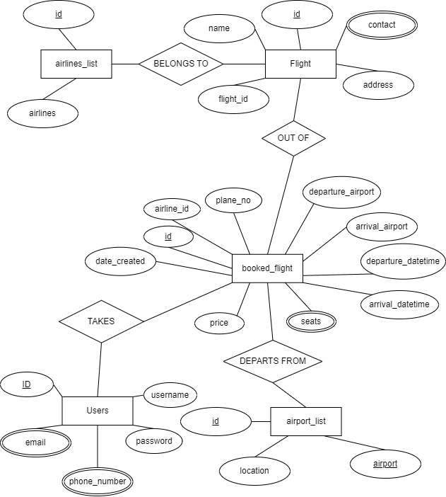
Entity Relation Diagram (ER Diagram)

Slide 9
Description of ER diagram:
Entities and Attributes:
Airlines: Represents different airlines. Attributes may include an auto-incremented ID and the name of the airline.
Airports: Represents various airports. Attributes may include an auto-incremented ID, the name of the airport, and its location.
Flights: Represents individual flights. Attributes may include an auto-incremented ID, the ID of the airline operating the flight, the plane number, departure and arrival airport IDs, departure and arrival datetimes, available seats, price, and creation timestamp.
Booked Flights: Represents flights that have been booked by users. Attributes may include an auto-incremented ID, the ID of the booked flight, the name, address, and contact information of the person booking the flight.
Users: Represents users of the system. Attributes may include an auto-incremented ID, username, password, email, and phone number.

Slide 10
Relationships:
Airlines and Flights: Each flight is operated by one airline, establishing a one-to-many relationship between Airlines and Flights.
Airports and Flights: Each flight has a departure and arrival airport, establishing two one-to-many relationships between Airports and Flights (departure and arrival).
Flights and Booked Flights: Each booked flight corresponds to one flight, establishing a one-to-many relationship between Flights and Booked Flights.
Users and Booked Flights: Each booked flight is associated with one user who made the booking, establishing a one-to-many relationship between Users and Booked Flights.
Attributes with Keys:
Primary keys are marked for each entity (ID fields).
Foreign keys are used to establish relationships between entities (e.g., airline_id, departure_airport_id, arrival_airport_id, flight_id).

Slide 11
Thank you
AP22110010179- Chirasani Likkith Reddy
AP22110010168- Bhuvanesh Reddy
AP22110010151- Amarnadh kalluri
AP22110010154- Surya Manava
AP22110010163- Nena Golla

